Slide 1
Supervised Learning – Classification Techniques
Session - 4
Session3
Aakash Goel , https://www.linkedin.com/in/goelaakash123/
Acknowledgment: Presentation developed by Prof. Arun. and Modified by Aakash Goel

Slide 2
Agenda
1
Classification Algorithm
2
Steps
3
Case study

Slide 3

Machine Learning Algorithms

Slide 4
Agenda
Introduction
Data Acquisition
Data Description – Data Flow diagram, documentation, data capture strategy,
Data Visualization – Matplotlib, PowerBI, Altair, -- Dashboarding
Data Normalization
Train-Test Split using Stratified Sampling
Backward Elimination
Hyperparameter Tuning using Randomized Search
Model Training
Model Evaluation
Confusion Matrix
Precision
Recall
ROC AUC
Optimal Threshold
Notes:
https://www.linkedin.com/pulse/100-open-source-big-data-ml-architecture-papers-sequel-anil-madan

Slide 5
Data Acquisition
Sources (Sensors, PLCs/SCADA, CNC Machines, ERP , Quality control, Energy Meters, Maintenance Logs)
Types
Structured –Tabular (rows, columns) – Sensor Logs, SCADA tables
Unstructured data – Needs Processing – Maintenance Notes, Images
Real-time Streaming – Continuous data – Vibration from machine motor
Historical/Batch data – Collected over period of time – Past production cycles
Challenges
Sensor drift/ failure – wrong reporting, failure
Missing timestamps –
Volume – GBs/day
Latency – Data not coming as fast as required
Best Practices
Data Logging standards – ISO 10303
Time Synchronization
Sensor health monitoring -- Monitor health of sensor – Meta sensors
Data validation Layer – check for ranges of data, types, spikes
Security – encrypted ..

Slide 6
Real world example
Predictive maintenance model for CNC machines
Vibration data (sensor)
Tool wear logs (operator input)
Production count (ERP)
Failure events

Slide 7
Classification method
Supervised Learning: Focus on Classification
Importance in Manufacturing: Defect Detection, Quality
Control
Techniques Covered:
Logistic Regression
Decision Trees
Model Evaluation Metrics
Notes:
https://www.linkedin.com/pulse/100-open-source-big-data-ml-architecture-papers-sequel-anil-madan

Slide 8
Classification method
Data Acquisition
Using faker library to create synthetic data
Dataset features:
Temperature, Pressure, Humidity, Speed (Numerical)
Material (Categorical)
Defective (Binary Target)
Introduced correlation for realistic scenario
Notes:
https://www.linkedin.com/pulse/100-open-source-big-data-ml-architecture-papers-sequel-anil-madan

Slide 9
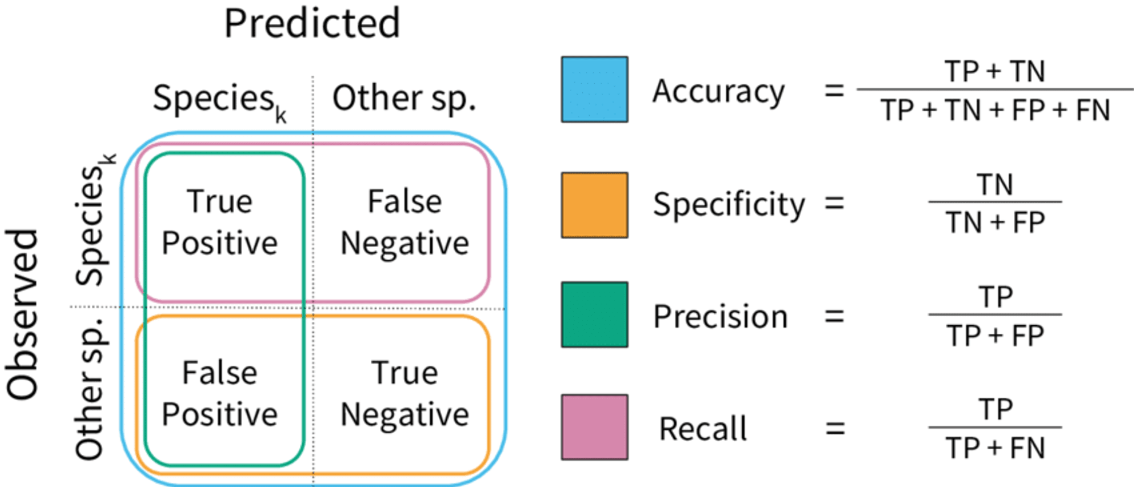









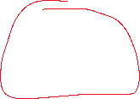
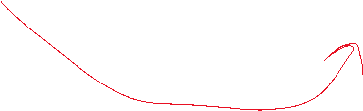



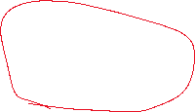


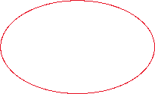
Classification method
Notes:
https://www.linkedin.com/pulse/100-open-source-big-data-ml-architecture-papers-sequel-anil-madan

Slide 10
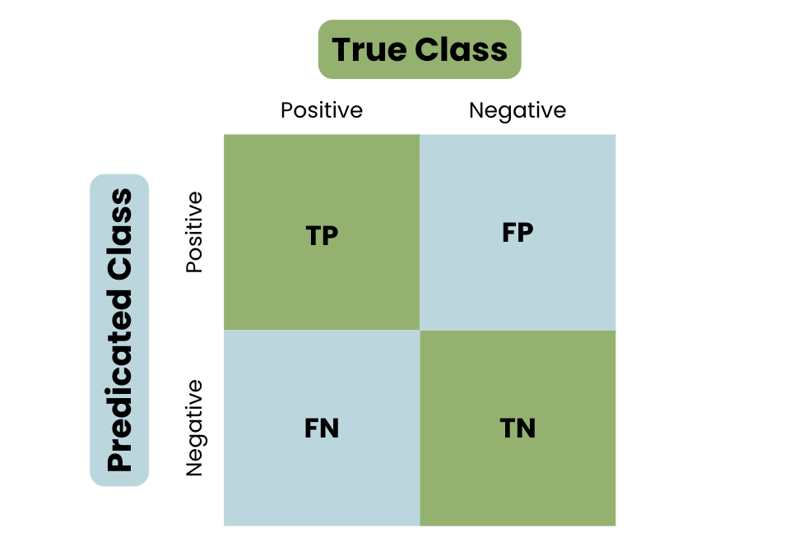
Classification method
Notes:
https://www.linkedin.com/pulse/100-open-source-big-data-ml-architecture-papers-sequel-anil-madan

Slide 11
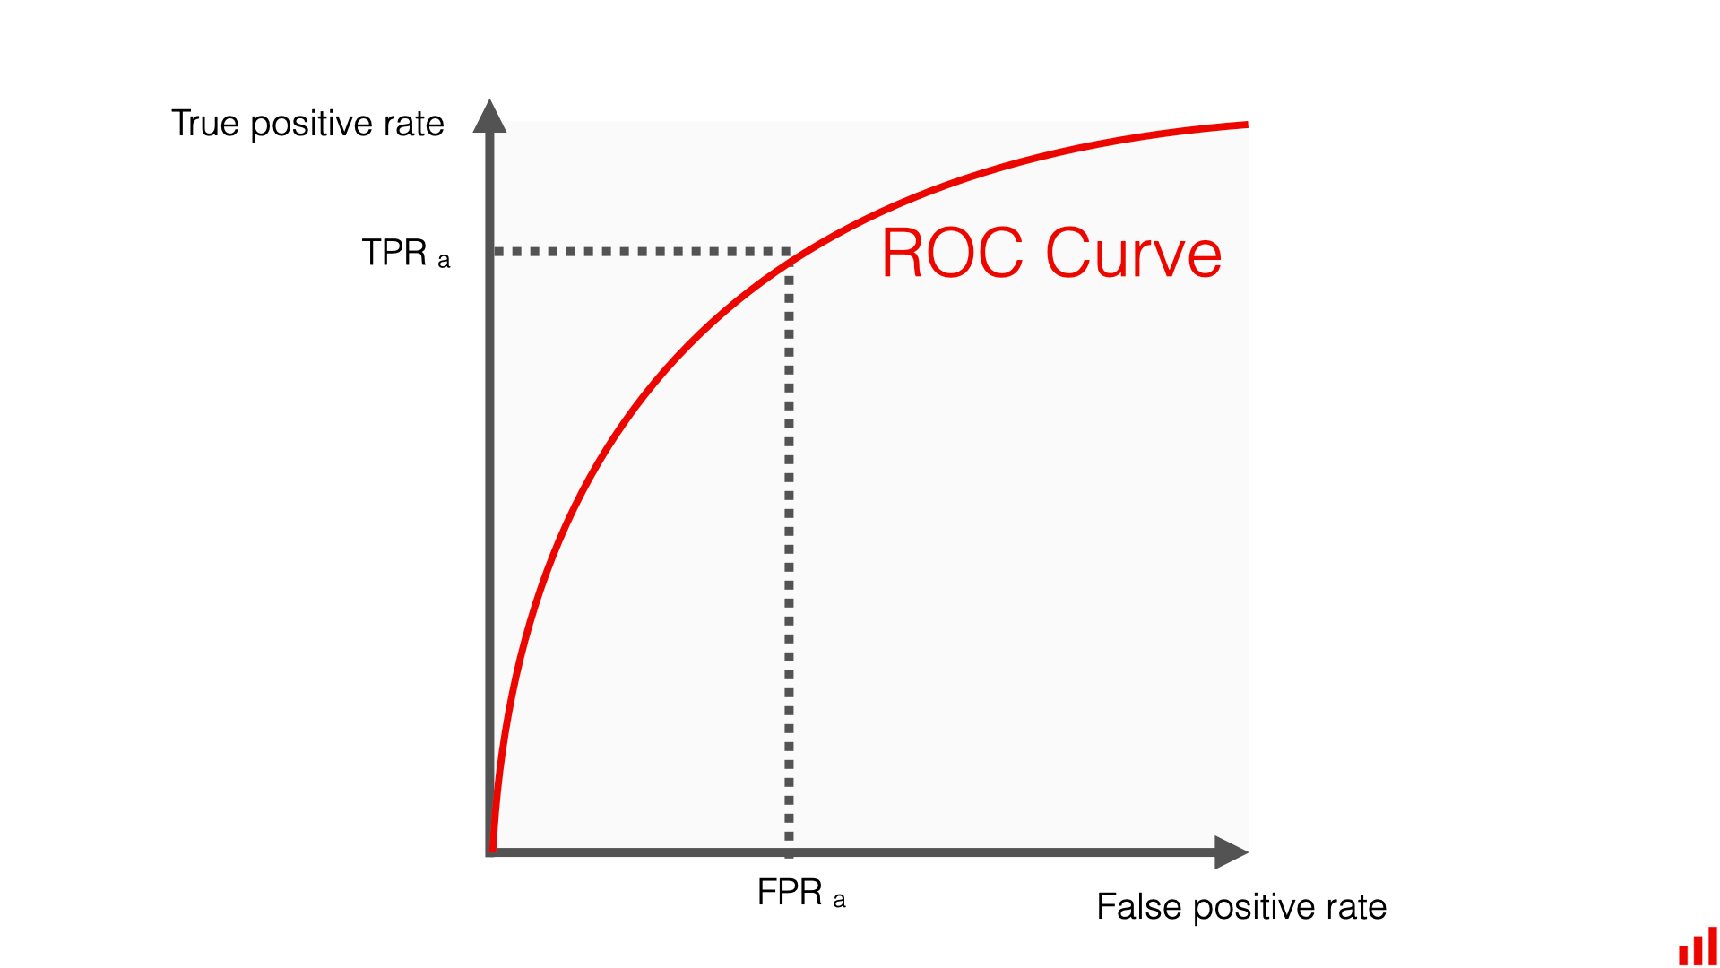
Classification method
Notes:
https://www.linkedin.com/pulse/100-open-source-big-data-ml-architecture-papers-sequel-anil-madan

